Slide 1
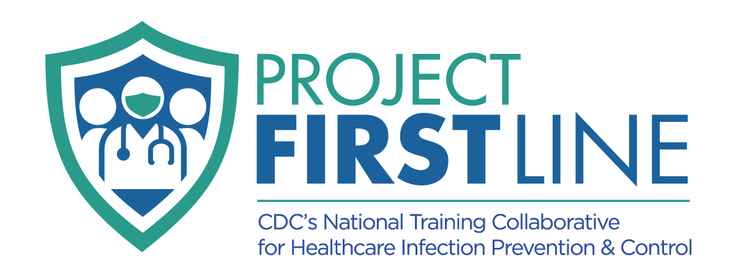
TOPIC 12: Environmental Cleaning & Disinfection: Why do cleaning and disinfection matter?
[Date of training]
Notes:
Facilitator Notes
Participants log in and get settled.

Slide 2
Agenda
Welcome
Cleaning and Disinfection: What is the Difference?
Why Cleaning and Disinfection Matter
Reflection
Notes:
Facilitator Notes
Welcome the group and add a greeting to the chat box.
You may adapt the introduction time as needed: spend time on introductions if there are new faces or if group members still do not know each other.
If this session is part of an ongoing series, you may choose to say “welcome back,” “thank you for joining us again,” etc.
Announce housekeeping notes, either orally or via chat.
If needed, additional notes specific to the platform you’re using (e.g., how to “raise your hand,” how to post questions)
Provide an overview of the agenda.
Sample Script
“Welcome to Project Firstline. Thank you for joining us! Before we begin, a few housekeeping notes. We’ll meet today for 10 minutes. Please keep your videos on, to the extent possible, and keep your microphone muted when you are not contributing to the discussion. It’s great to see you all here today!
“Today we’ll focus on another essential part of infection control: cleaning and disinfection. What are they? What is the difference between them? And why do they matter?

Slide 3
Learning Objectives
Describe the difference between cleaning and disinfection.
Why do cleaning and disinfection matter in healthcare?
Notes:
Sample Script
“By the end of today’s training, you will be able to describe the difference between cleaning and disinfection, and why they matter in healthcare.”

Slide 4
Cleaning and Disinfection: What is the Difference?
Notes:
Facilitator Notes
Help participants think about moments in their daily work when they might clean or disinfect surfaces or objects.
Encourage participants to make note of their thoughts.
Sample Script
“Let’s get started.
“As we watch this episode of Inside Infection Control with the CDC’s Dr. Abby Carlson, start thinking about your workday. In your participant booklet, jot down instances when it may be important to clean, or disinfect, or both.
“Now let’s watch the video to make sure everyone is on the same page.”

Slide 5
Inside infection control, episode 16: Cleaning? Disinfection? What is the difference?
Notes:
Facilitator Notes
Access the video here:
CDC Website: https://www.cdc.gov/infectioncontrol/projectfirstline/videos/Ep16-CLEANING-LoRes.mp4
OR
Project Firstline YouTube Playlist: https://www.youtube.com/watch?v=dIuRI9OpjnY

Slide 6
Definitions
Cleaning Cleaning is a process that removes things like dust, dirt, grime, and other spills, smears, and everyday messes from surfaces, along with some germs.
Disinfection Disinfection is a process that kills germs.
Notes:
Facilitator Notes
Either allow time for participants to read the definitions themselves or read them aloud.
Sample Script
“As you heard from Dr. Carlson, cleaning removes visible dirt, dust, spills, smears, and grime, including organic material like blood, as well as some germs, from surfaces. It’s important to clean before disinfecting because dirt and grime can make disinfectants not work as well. And we need disinfectants to work to kill germs on surfaces or objects.
“Did you already know the difference between cleaning and disinfection? Or is there anything about these definitions that was new to you?”
(Acknowledge responses.)

Slide 7
Why cleaning and disinfection Matter
Notes:
Facilitator Notes
The bullet points on the following slides summarize content from Episode 20 of Inside Infection Control: Why Do Cleaning and Disinfection Matter in Healthcare? bit.ly/WhyCleanAndDis. For time reasons, the video is not shown during the 10-minute sessions.
If time allows, feel free to show the video or to share it as an extension activity.
Sample Script
“We’ve talked about the ways that cleaning and disinfection are part of our daily work life and how they work. Remember, cleaning is an important step because, if we try to disinfect something that isn’t clean, the disinfectant might not work. And we need disinfectants to kill germs. Now let’s take a few minutes to talk about why this is so important in healthcare.”

Slide 8
Patients may have weakened immune systems
In healthcare, we have patients who are ill or weak.
Why does that matter?
Germs are more likely to cause problems in these patients, because their immune defenses may not be the same as someone who is healthy and living at home.
Notes:
Facilitator Notes
This slide has animations for the second column. When you advance to the slide, only the first column will appear.
After you introduce the concept, ask participants to share, either orally or in the chat, answers to the question, “Why?”
After they provide responses, use the animation to reveal the answers.
You may wish to refer to the Content Outline for Episode 20 for additional discussion points.
Sample Script
“Cleaning and disinfection are critical in healthcare for many reasons. It’s common sense that we don’t want a dirty environment for our patients – but why is that? Does anyone have any thoughts?”
(Pause for responses, then advance to reveal second column.)
“Yes! One reason is because, in healthcare, we have patients who are ill and may not be able to fight off infections as well as someone who is healthy. Germs are more likely to cause problems in these patients because their immune defenses might not be as strong as someone who’s healthy.
“It’s possible to see how some patients might be at risk of infection, such as if they have burns or wounds, or if they’re having a procedure when germs could get into their bodies, such as getting an IV or a catheter. But many patients’ risks for infection can’t be seen, like when a patient’s immune system is weak because of the medication in their cancer treatment.”

Slide 9
The healthcare environment should be kept clean
It is important to keep the healthcare environment clean to stop germs from spreading.
Where and When?
Patient Rooms
High-touch Surfaces
Bed rails
Keyboards
Light switches
Surfaces and objects that often have a lot of germs on them
Toilet seats
Notes:
Facilitator Notes
This slide has animations for the second column. When you advance to the slide, only the first column will appear.
After you introduce the concept, ask participants to share, either by coming off mute or via chat, answers to the question, “Why?”
After they provide responses, use the animation to reveal the answers.
You may wish to refer to the Content Outline for Episode 20 for additional discussion points.
Sample Script
“It’s important to keep the healthcare environment clean to stop germs from spreading. What are some places that you can think of that need to be cleaned and disinfected often?”
(Pause for responses, then advance to reveal second column.)
“There are a lot in healthcare! Think about patient rooms. When a patient leaves a room or is discharged, before a new patient goes into that room, it should be cleaned and disinfected to make sure germs don’t spread.
“What about high-touch surfaces? We also clean and disinfect things that get touched a lot, such as bed rails, keyboards, and light switches. These ‘high-touch surfaces’ need that frequent cleaning and disinfection.
“What else? It’s also important to clean and disinfect things in healthcare that aren’t touched or shared as often but tend to be dirty and have a lot of germs on them, like toilet seats.”

Slide 10
Reflection: What did you learn today?
Notes:
Facilitator Notes
Invite participants to share what they learned during the session.
Encourage participants to describe actions that they can take to use what they have learned. They may come off mute and speak, or type in the chat, or both.
As appropriate, make connections between participants’ responses and the material from the session, particularly “why” cleaning and disinfection are so important in healthcare.
Invite additional, remaining questions.
If the answers are information that is already included in this session, please respond.
If the questions address content that is not covered in this session, please do not attempt to answer. Instead, take note of the questions and consult with CDC resources to follow up with answers after the session.
Sample Script
“Let’s use our last few minutes together to reflect on what we’ve covered today and think about how we can learn more and put what we’ve learned into practice.
“I’d love to hear from you about what you learned today. Would anyone like to share?”
(Acknowledge and address responses.)
“As we just heard, you’ve learned a lot today. I’d like you to identify one thing you’ll need to do, or continue to do, in your daily work to help keep the healthcare environment clean and stop germs from spreading.”
(Acknowledge and address responses.)
“Thank you for sharing! Does anyone have any questions still remaining?”
(Address questions as appropriate.)
“Thank you for sharing those questions. Project Firstline is actively collecting your questions to help inform more training resources as they’re developed. I’ve written them down, and I will get back to you with responses.”

Slide 11
Key Takeaways
Cleaning removes visible dirt, dust, spills, smears, and grime, including organic material like blood, as well as some germs, from surfaces. It’s important to clean before disinfecting because dirt and grime can make disinfectants not work as well.
Disinfecting kill germs on surfaces or objects.
It is important to keep the healthcare environment clean to stop the spread of germs.
Notes:
Facilitator Notes
Review key takeaways.
You may choose to revisit discussion points or questions that arose during the session.
Sample Script
“I hope this training gave you some good information about cleaning and disinfection and why it’s so important to do them correctly in healthcare. I’ve captured some key takeaways here, which you can review at your leisure after the session today.”

Slide 12
Resources and Future Training sessions
Project Firstline Resources
Other Resources
Project Firstline on CDC:
https://www.cdc.gov/infection control/projectfirstline/index.html
Project Firstline on Facebook:
https://www.facebook.com/CDCProjectFirstline/
Twitter:
https://twitter.com/CDC_Firstline
Youtube:
https://www.youtube.com/playlist?list=PLvrp9iOILTQZQGtDnSDGViKDdRtIc13VX
To sign up for Project Firstline e-mails, click here: https://tools.cdc.gov/campaignproxyservice/subscriptions.aspx?topic_id=USCDC_2104
CDC’s Environmental Cleaning Evaluation Tools: https://www.cdc.gov/hai/prevent/prevention_tools.html#anchor_1561577385
CDC’s Reduce Risk from Surfaces: https://www.cdc.gov/hai/prevent/environment/surfaces.html
EPA’s Six Steps for Safe & Effective Disinfectant Use: https://www.epa.gov/sites/production/files/2020-04/documents/disinfectants-onepager.pdf
EPA’s List N Tool: https://cfpub.epa.gov/giwiz/disinfectants/index.cfm
About List N: Disinfectants for Coronavirus (COVID-19): https://www.epa.gov/coronavirus/about-list-n-disinfectants-coronavirus-covid-19-0
Selected EPA-Registered Disinfectants: https://www.epa.gov/pesticide-registration/selected-epa-registered-disinfectants
List N - Infographic Which disinfectants kill COVID-19?: https://www.epa.gov/sites/production/files/2020-12/documents/list_n_how-to_infographic_final_0.pdf
Environmental Cleaning & Disinfection
Notes:
Facilitator Notes
Share additional resources from Project Firstline and CDC.
If this session is part of a series, you may choose to describe the themes of upcoming sessions.
Sample Script
“That’s great, thank you. We covered a lot today, and there is still more to learn. You can keep exploring these topics on your own using the resources on this slide. You can also follow us on social media.”
(If this session is part of a series) “Next time, we will cover [insert next training topic].”

Slide 13
Feedback Form
Notes:
Facilitator Notes
Explain how to access the feedback form.
Sample Script
“And, finally, please let us know how you enjoyed today’s session by completing the following feedback form. Thanks again for joining us today.”
After the Session
Send list of participant questions compiled during this session to ProjectFirstline@cdc.gov.

